Slide 1
Combimac permanent magnet motor

Slide 2
Rating data, input
Supply voltage: 650V, 3ph
Rated frequency: 166.7 Hz
Continous Power (2 windings): 131 kW
Power factor: 0.97..0.98
Nominal current (2 windings): 123 A
Maximum current: 123 A (No overload)
Connection: Star
Back EMF: 766V +/- 10%
Inductance L-L 1 winding: 5.88 mH Xdd
Resistance L-L 1 winding: 210 m ohm

Slide 3
Output
Rated speed: 2000 RPM
Rated torque: 625

Slide 4

Power and torque curves
$P_{m}=T_{m}∗ω_{m}$
Where:
$P_{m}$, is motor power [W]
$T_{m}$, is motor torque [Nm]
$ω_{m}$, is motor speed [rad/s]
$T_{m}$, is 625Nm up to field weakening
$T_{m}={\left(T_{m,r}∗ω_{m,r}\right)}/{ω_{m}}$ in field weakening
Where:
$T_{m,r}$, is rated torque
$ω_{m,r}$, is rated speed

Slide 5
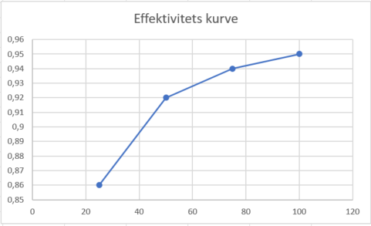
Efficiency-η 1/2
4 points given in data sheet
100% load – η=95%
75% load – η=94%
50% load – η=92%
25% load – η=86%

Slide 6
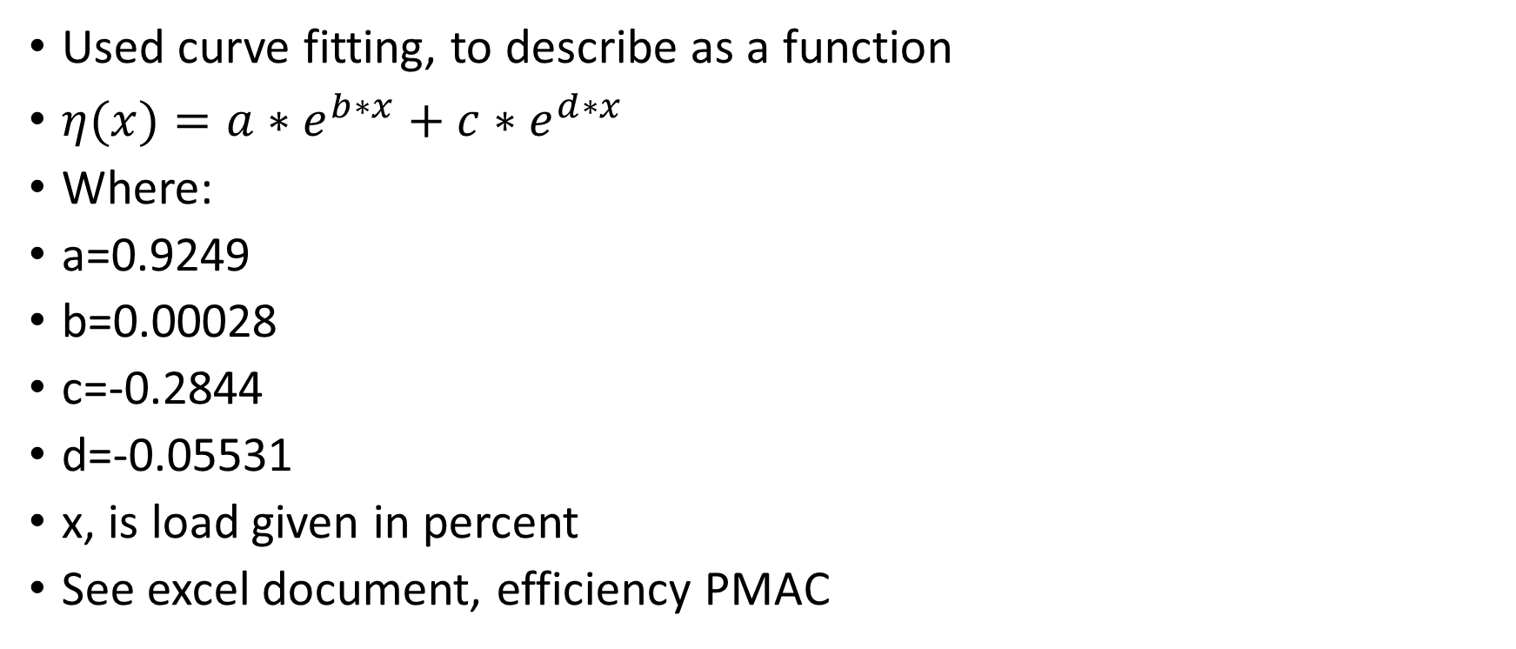
Efficiency-η 2/2
Used curve fitting, to describe as a function
$η(x)=a∗e^{b∗x}+c∗e^{d∗x}$
Where:
a=0.9249
b=0.00028
c=-0.2844
d=-0.05531
x, is load given in percent
See excel document, efficiency PMAC

Slide 7
Construction
Frame size: 200L B5
Mass: 225 kg (estimated)
Bearing: 6313-2Z-C3 (SKF) D.E and N.D.E
Air gap (magnetic): 3 mm
Air gap (mechanical): 2 mm
Ingress protection: IP 56 (5 is dust protection, 6 is powerful waterjets)
Encoder: ECN 113 13 bit (Heidenhain)
Balancing level ISO1940-1, G1
Balancing method ISO21940-32, no key
Rotation viewed on DE: clockwise
Winding 1-2 electric phase shift 30 degrees, winding 2 lagging when looking on shaft

Slide 8
Stator
Outer diameter: 320 mm
Inner diameter: 230 mm
Core length: 160 mm
No. Coils: 60

Slide 9
Rotor
Outer diameter: 224 mm
Inner diameter: 150 mm
No. of magnet poles: 10
Magnet material: FeNdB40UH
Inertia: t.b.d kgm²

Slide 10
Cooling and losses
Method: IC7A1W7
Coolant pressure: 4 bar
Pressure drop: max 0.5 bar
Losses to coolant: 5.7 kW
Losses to air: 0.25 kW
Coolant flow min: 8 l/min
Coolant flow max: 10 l/min
Coolant temp in: 27-34 degrees

